Slide 1
UNIT-4
Chapter-15 Interactions

Slide 2
Interactions
An interaction is a behavior that comprises a set of messages exchanged among a set of objects within a context to accomplish a purpose.
A message is a specification of a communication between objects that conveys information with the expectation that activity will ensue.

Slide 3
Objects and Roles
The objects that participate in an interaction are either concrete things or prototypical things.
As a concrete thing, an object represents something in the real world. For example, p, an instance of the class Person, might denote a particular human.
Alternately, as a prototypical thing, p might represent any instance of Person.

Slide 4
Links
A link is a semantic connection among objects. In general, a link is an instance of an association.
As shown in the figure, wherever a class has an association to another class, there may be a link between the instances of the two classes;
wherever there is a link between two objects, one object can send a message to the other object.
A link specifies a path along which one object can dispatch a message to another (or the same) object.

Slide 5
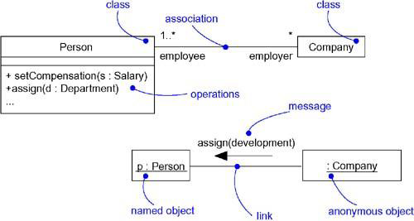
Links and Associations

Slide 6
Messages
A message is the specification of a communication among objects that conveys information with the expectation that activity will result.
When a message is passed, the result is an action. An action may result in, a state change.

Slide 7
There are several kinds of actions.
call- Invokes an operation on an object (an object may send a message to itself).
return-Returns a value to the caller
send -Sends a signal to an object
create - Creates an object
destroy -Destroys an object; an object may be destroying by itself.

Slide 8
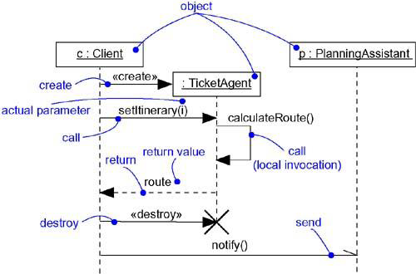
Messages

Slide 9
Sequencing
When an object passes a message to another object the receiving object might in turn send a message to another object, which might send a message to yet a different object, and so on. This stream of messages forms a sequence.

Slide 10
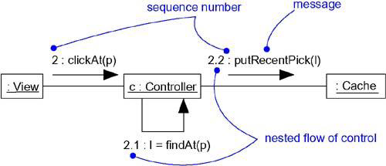
Procedural Sequence

Slide 11
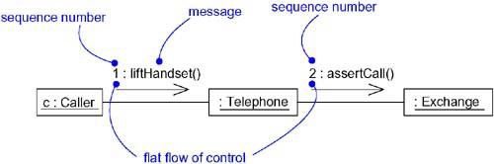
Flat Sequence

Slide 12
Creation, Modification, and Destruction
Most of the time, the objects participating in an interaction exist for the entire duration of the interaction.
The same is true of links: the relationships among objects may come and go. To specify if an object or link enters and/or leaves during an interaction, one of the following constraints are attached to the element:
1. new - Specifies that the instance or link is created during execution of the enclosing interaction
2. destroyed- Specifies that the instance or link is destroyed prior to completion of execution of the enclosing interaction.
3. transient- Specifies that the instance or link is created during execution of the enclosing interaction but is destroyed before completion of execution

Slide 13
Representation
When we model an interaction, objects and messages are included.
Objects and messages involved in an interaction are visualized in two ways:
- by emphasizing the time ordering of its messages.
-by emphasizing the structural organization of the objects that send and receive messages.
Both sequence diagrams and collaboration diagrams are kinds of interaction diagrams.
Sequence diagrams and collaboration diagrams are largely isomorphic, meaning that you can take one and transform it into the other without loss of information.

